Slide 1
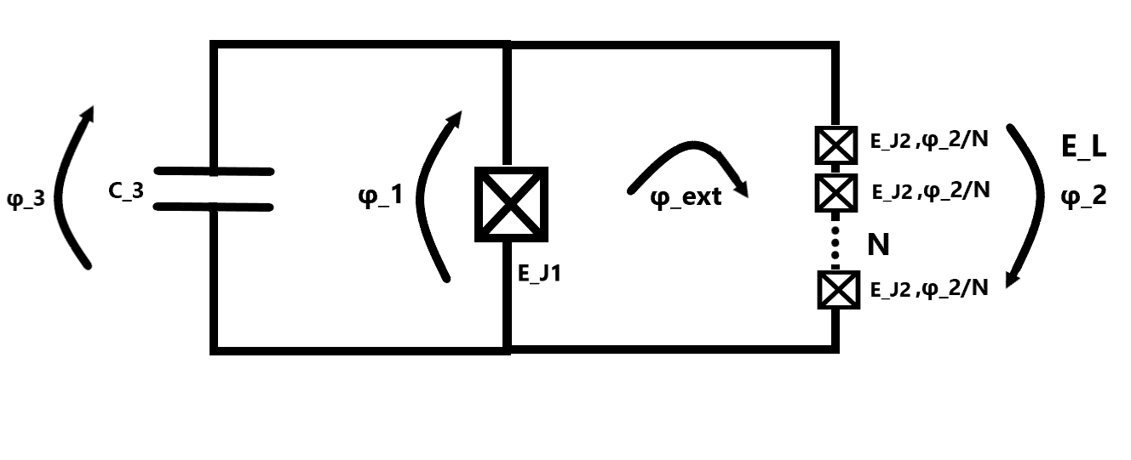
Fluxonium
2023-08-02 Group meeting
Amalie T. J. Paulsen

Slide 2
Master thesis project plan
Resonators
Josephson junctions
Transmon
Flux tunable Transmon
Fluxonium

Slide 3
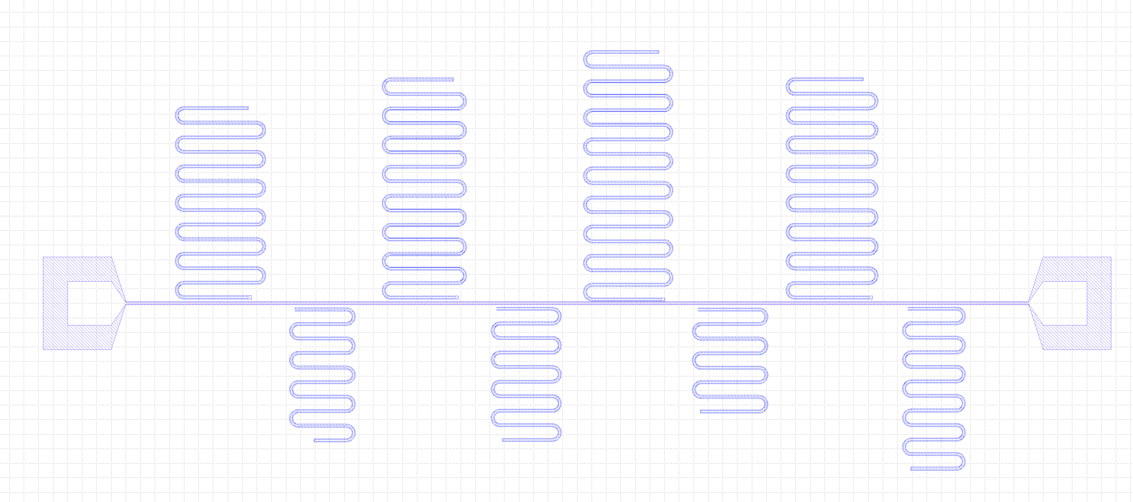
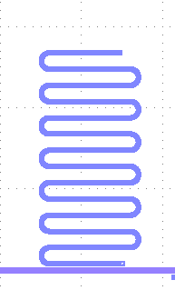
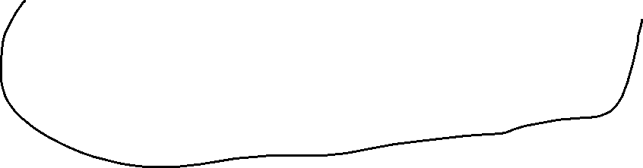

Resonators – overview of the setup
3
1
2
4
VNA
7
5
6
8
Notes:
In the resonator chip we have the transmission line with a bonding pad in each end connected to a VNA. Through the VNA, we send photons thorugh the transmission line with a given frequency and power (in dB) (and other settings.
Then we have 8 resonators capacitively coupled to the transmission line. Each have different frequencies in order to distinguish between them.
What determines a resonator?
The frequency (depend on the length)
Quality factor.
The impedance(depend highly on the geometry)

Slide 4
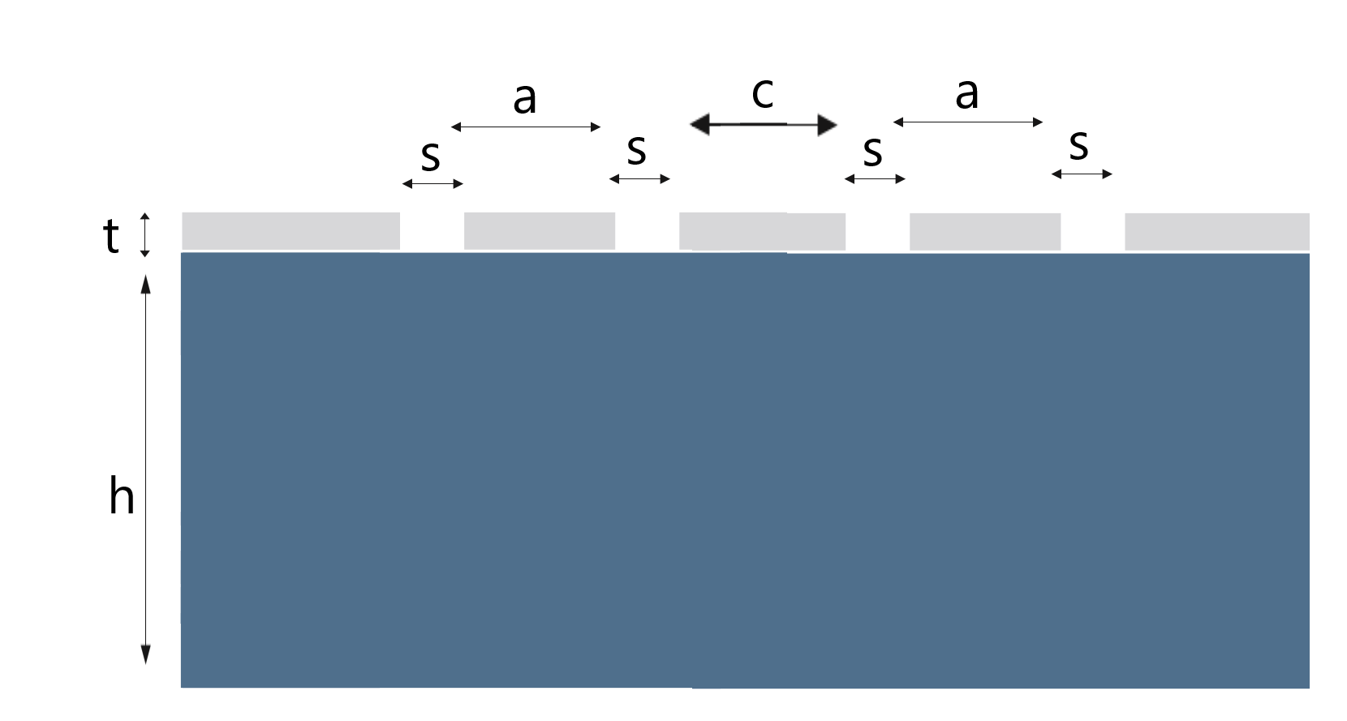
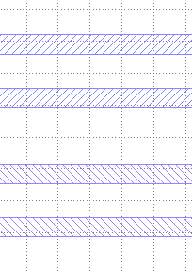
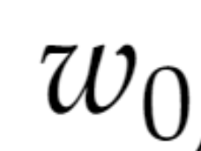
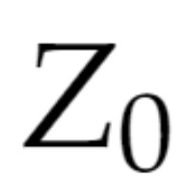
Resonators – Device geometry
l
lc
Notes:
In order to find the frequency and the Quality factor, we need to look at the device geometry.

Slide 5
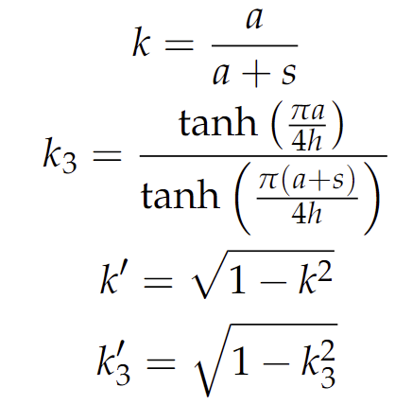
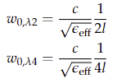
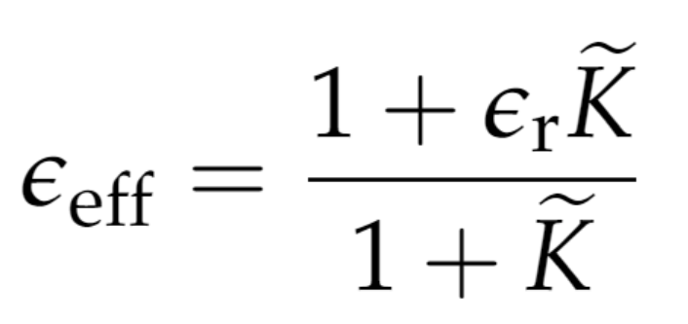
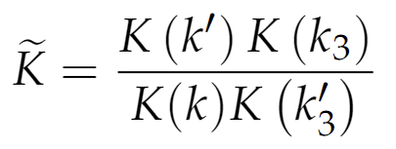
Resonators – Frequency
l
lc
Notes:
We usually work with 2 type of resonators, lambda2 and lambda4 resonators where the only difference is wheather they are open- or short-circuited the length dependence with the frequency. We want the resonators to have different frequencies and therefore, we give them different lengths.
Make new pictures of when you understand. + make the waves.
Where e_ff is the effective dielectric constant of the resonator dependent on the type of material (the dielectric constant of our material) as well as the dimensions of the resonator. For Al, the dielectric constant is 9.5-10 according to Pozar (at room temperature), we are working with sc (millikelvin and we therefore take the dielectric constant to be. 11.75?? Get the numbers from Zhavid or Micheala.
There are a lot of different equations, but the most important thing is, that we can estimate the frequencies by varying the length, so each resonator has a different resonator-frequency.
– we typically use frequencies between 4-8 GHz

Slide 6
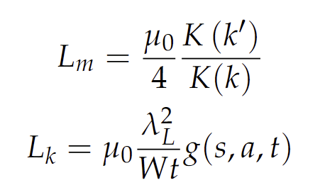
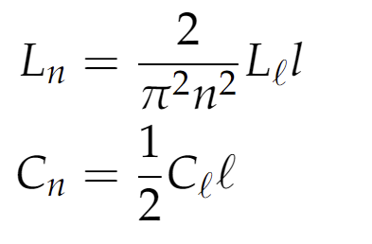
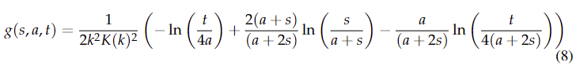
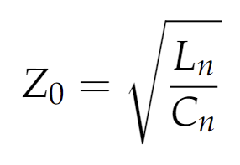
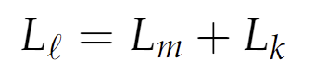
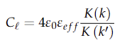
Resonators – Impedance
l
lc
Notes:
- The quality factor depend on many different parameters among others, the impedance which is depended on the device geometry like the frequency
- We want to design our circuit in such a way, that everything is impedance matched.
If there is an impedance mismatch, there can occur unwanted scattering and reflection.
We typically try to hit. 50Ohm impedance since it is the impedance of our cables.
Our transmission line and our resonator are both made of Al.
To have our transmission line and resonator to have 50 Ohm impedance we will give them the following sizes: A = 10,7 micrometer, S = 6 micrometer. We can use a python script and ansys to calculate these sizes.
It is a measure of how big of a opposition there is to the electron flow.
If you change the device geometry during fabrication (which will most likely happen, you will also change the the impedance of either the transmission line or the resonator which will cause impedance mismatch.

Slide 7
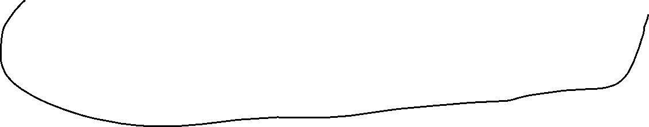

Resonators – Measurement
VNA
Ph
Ph
Ph
Notes:
When the transmission line is coupled to the resonator, x# of photons goes into the resonator. (yearh you thought that only the ones with the resonance frequency went into the resonator – I also thought that.
The number of photons going into the resonator is proportional with the capacitance and the power you send through the transmission line.
When the frequencies of the photons matches the frequencies of the resonator, the photons, can jump up in the resonator
It could be nice if I made a simulation of how the photons interact.

Slide 8
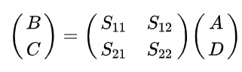
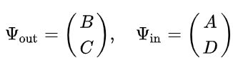
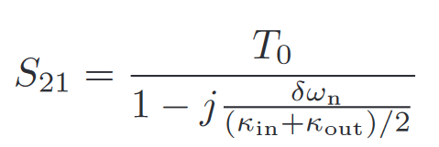
Resonators – Scattering matrix
Notes:
The scattering matrix tells us how an incoming wave behaves (either gets scattered or reflected). something about how big of a photon fraction which gets scatted, transmitted and reflected.
However, we are mostly interested in the transmission (that is how many photons survive from one pad to the other.
We typically do this for many different frequencies and powers. This is enough informations to find the frequency and the quality factors.

Slide 9
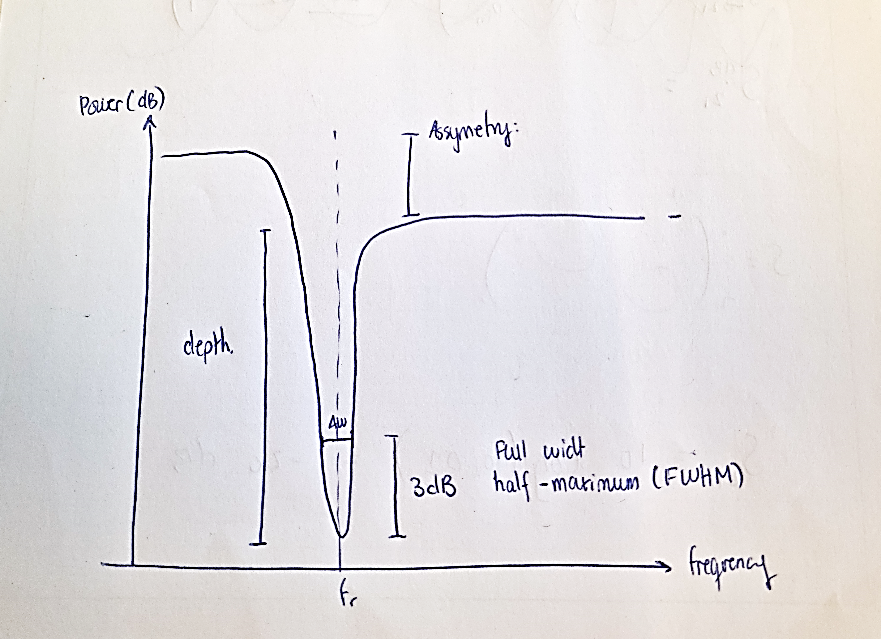
Resonators – S21, analysis of data
https://github.com/cqed-at-qdev/resonator
Notes:
The depth S21 min depend on the Q-dactors . The Q-factors depend on power which can be seen as the number of photons pr. Seccond
This also mean, that Qe and Qi is determined for the whole resonator peak.
- A VNA is connected to Labber. Via the VNA, we can measure the transmission (S_21) in dB (logarithmic) as a function of the frequency.
- In python using the Library “resonators” we fit the resonator peak to a Lorentzian.
- We can get the width and the length of the peak and put up 2 equations with 2 unknowns.
The picture we can draw:
The Q-factors tell you something about how well the resonators are to store the energy given vs. how fast it is dissipated.
Loss due to TLS can lower Q_i (what happens?) so the photon goes into the resonator, but because of the high power, it can easily go into the second state? does it go into the second state before or after it is emitted from the first state of the resonator?

Slide 10
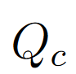
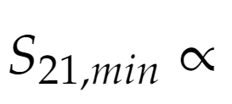
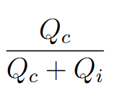
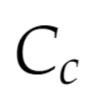
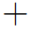
Resonators - The amplitude of the resonator dip (depth)
Ph
Ph
Ph
Notes:
So why is there a depth?
I talked to Jacob: some photons goes into the resonator goes back and furth some times, and then go back into the transmission line now with an acquired new phase which will interfere destructively with some of the photons not going up into the resonator. (which is why you will se a dip (which is lack of signal).
I Call the photons going back to the feedline for the Q_c photons where Q_c is the coupling factor. And tells us something about how long time the photons will live inside the resonator
The depth is

Slide 11
Resonators - The width of the resonator dip
Ph
Ph
Ph
Notes:
The photons which is scattered out from the the resonator we call the Q_i photons.
I talked to Jacob, and I am still not completely sure why there is a width. But it is also proportional with Q_i and Q_c. so by knowing the width and the depth from a fitting, you can extract the Q_i and Q_c

Slide 12
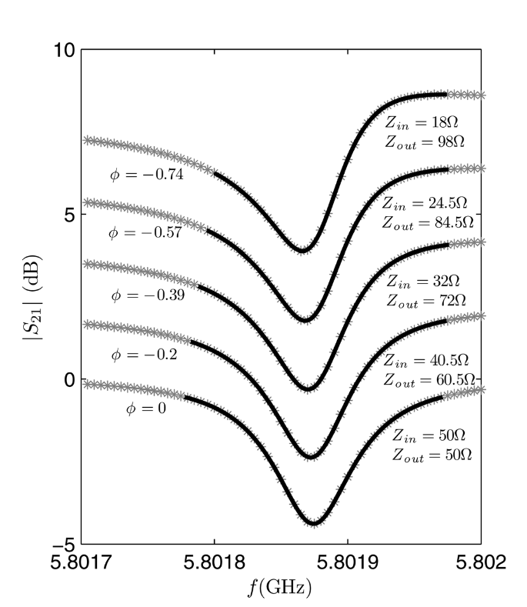
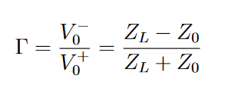
Resonators - The asymmetry of the transmission
Notes:
Empedance mismatch between the feedline and the resonator can lead to reflection (with a different phase) of the photons as well as photon energy loss. The transmission and the reflection have the following relation:
Khalil 2012
Either the frequencies (the waves are too short or to long) and the waves will interfere differently (either completely destructive or only a bit.

Slide 13
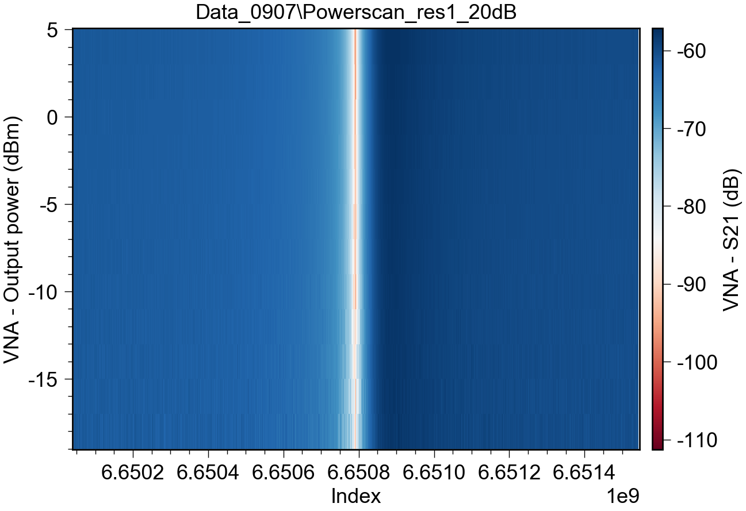
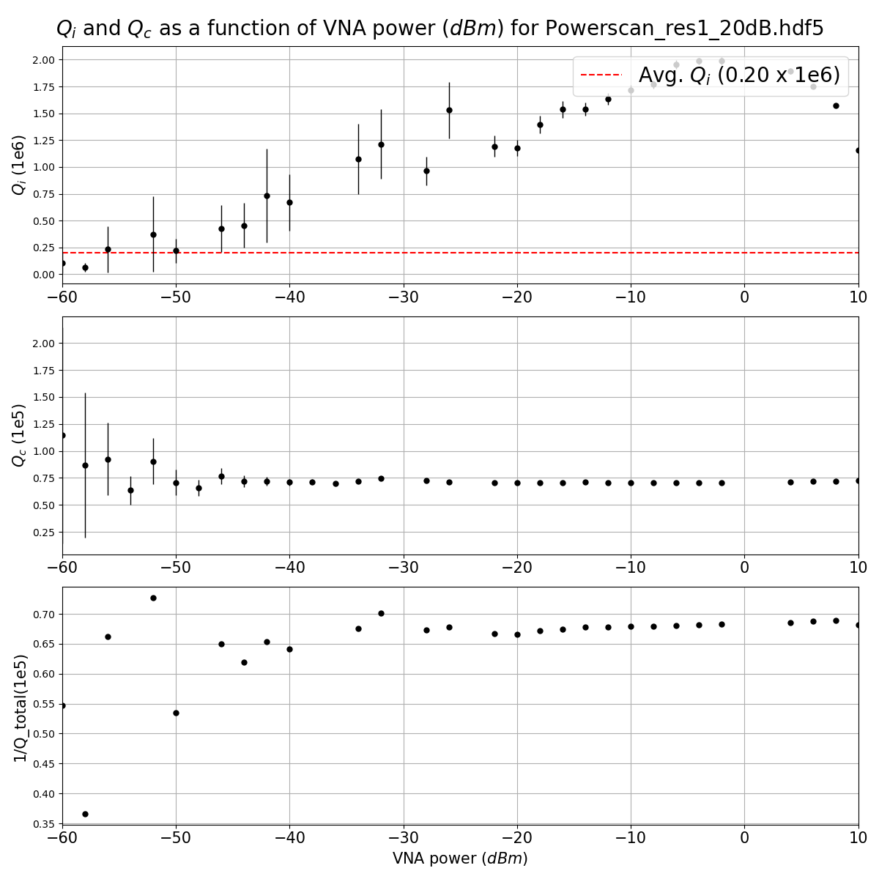
Resonators – Measurement and data treatment
We had some bad ones
Notes:
In general, the worst Q_factor was around 200.000 and the best was around 800.000 but in general they lyed between 400.000 and 600.000.

Slide 14
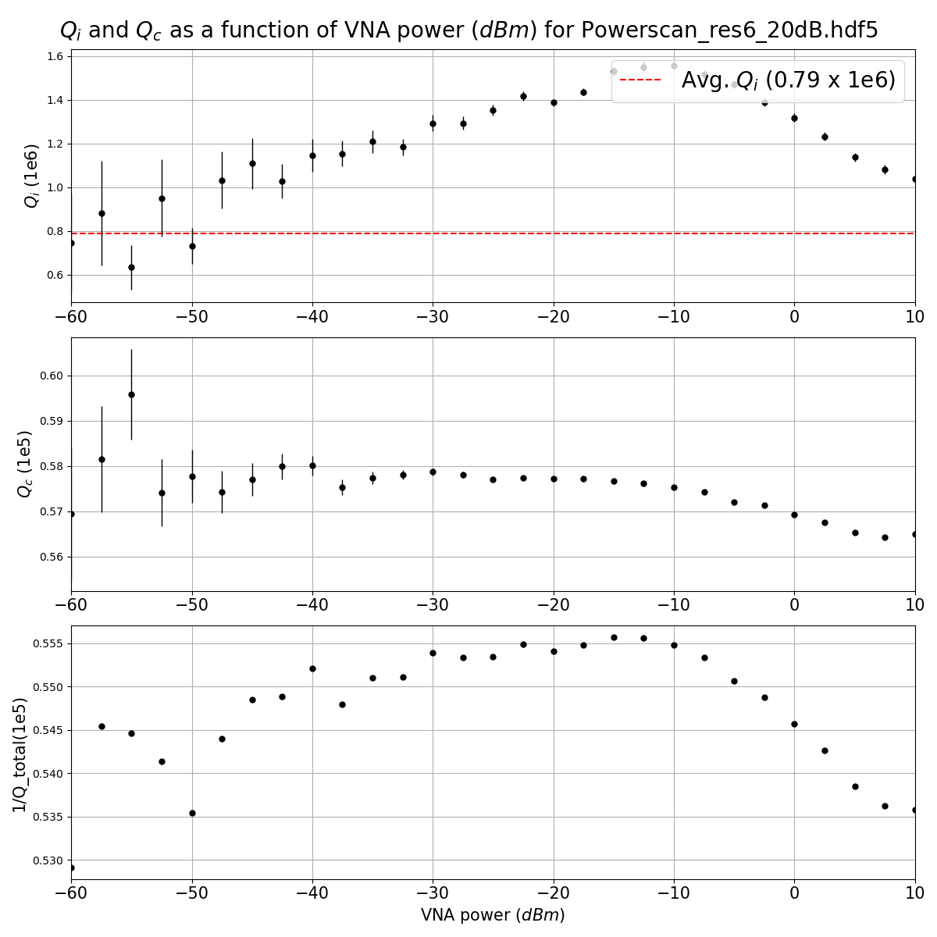
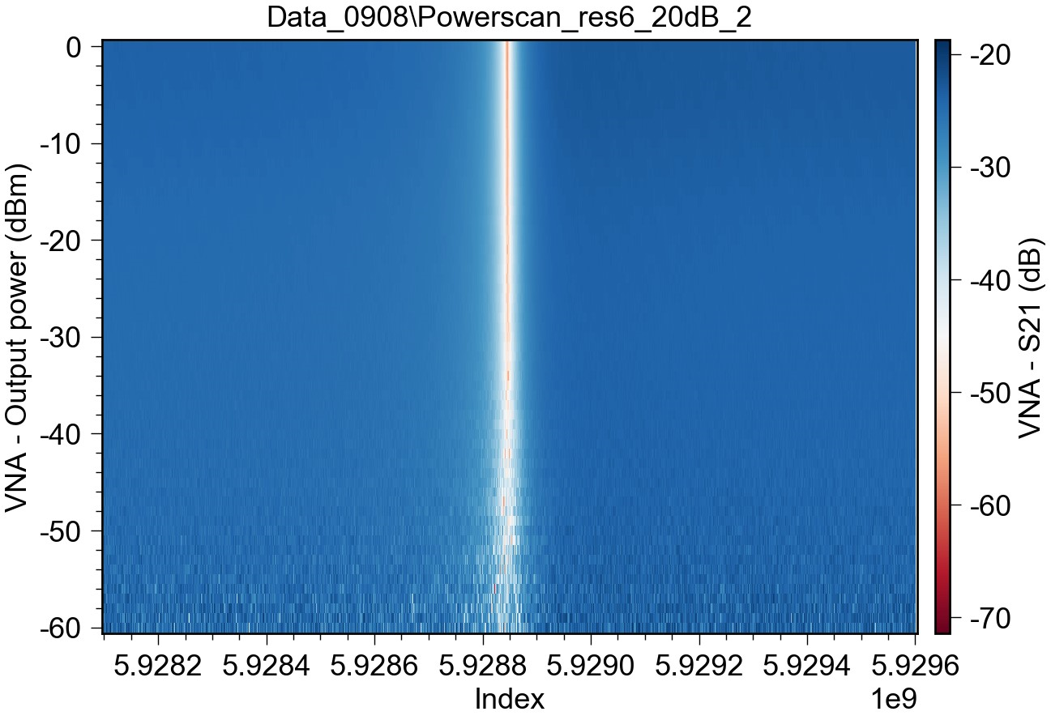
Resonators – Measurement and data treatment
We had some good ones

Slide 15
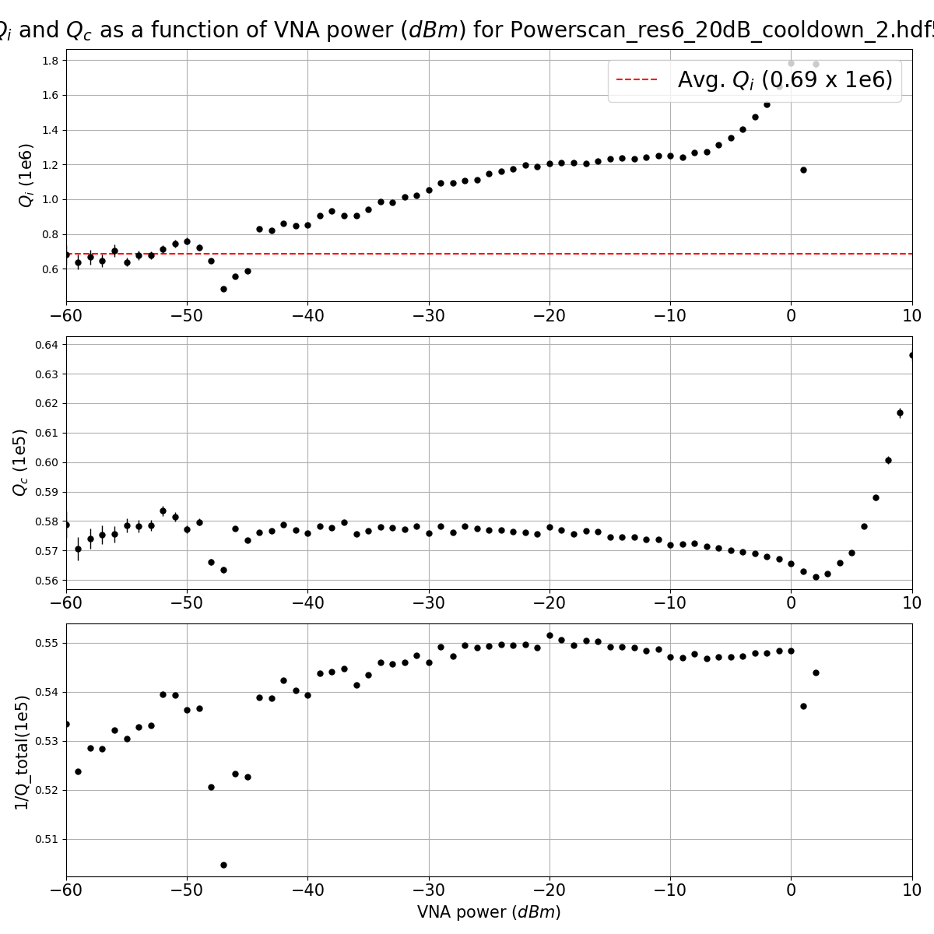
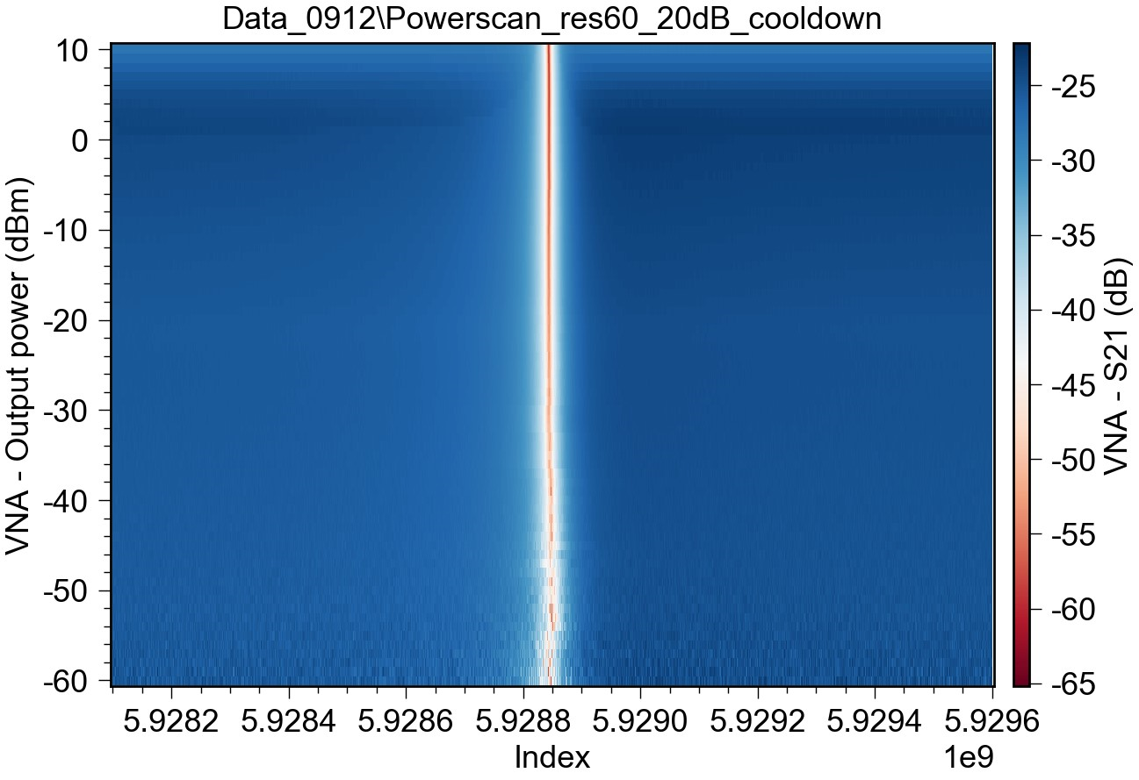
Resonators – Measurement and data treatment
Became better after re-cooldown
Notes:
The frequency did not shift after cool-down. However, the Q_factors did. They generally became better after cooldown

Slide 16
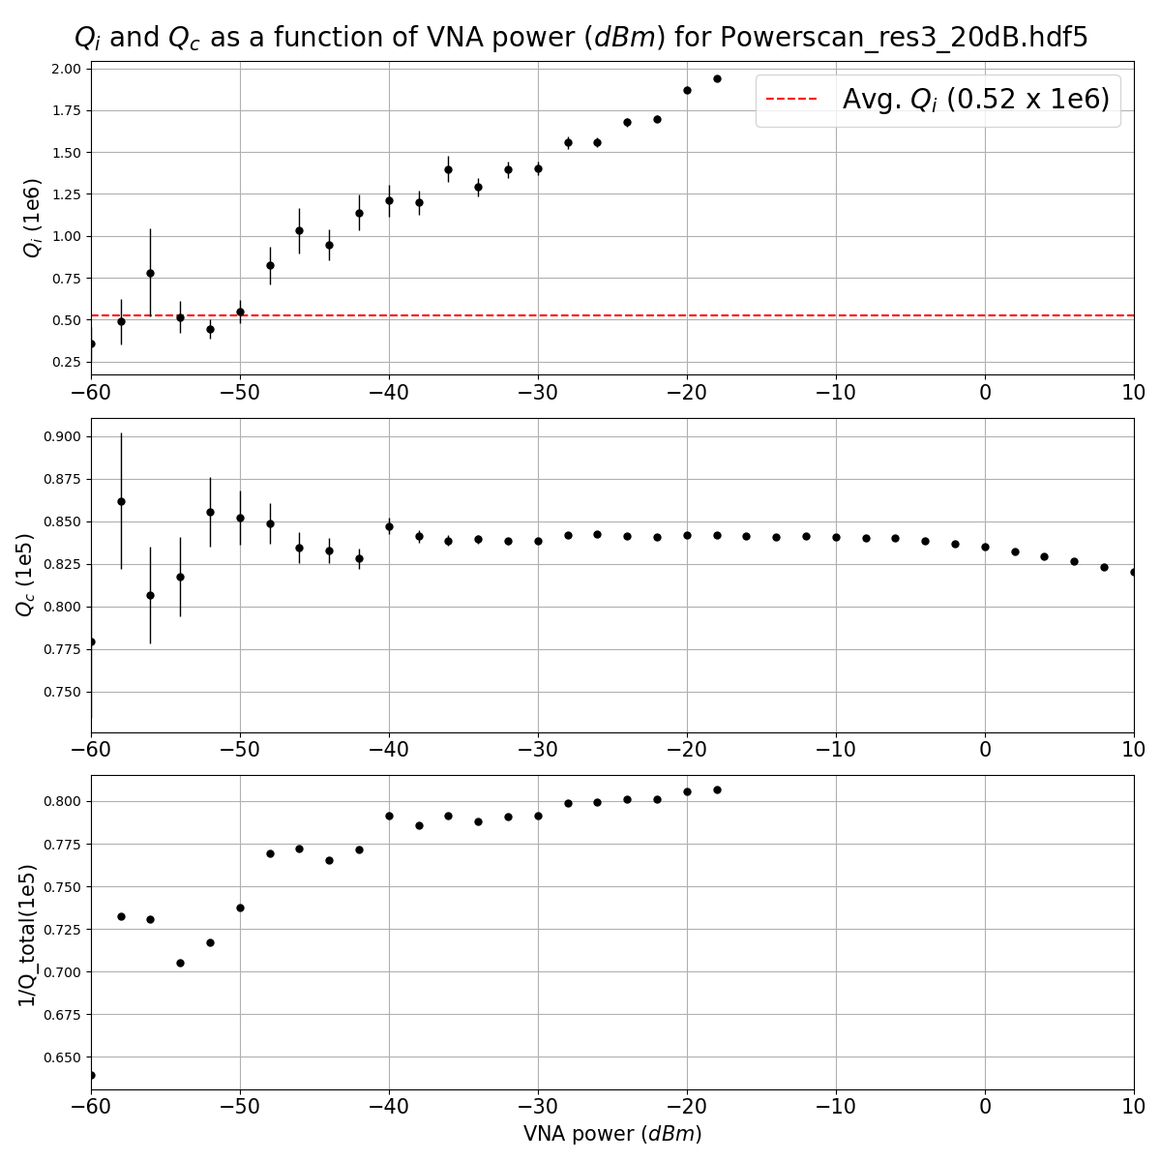
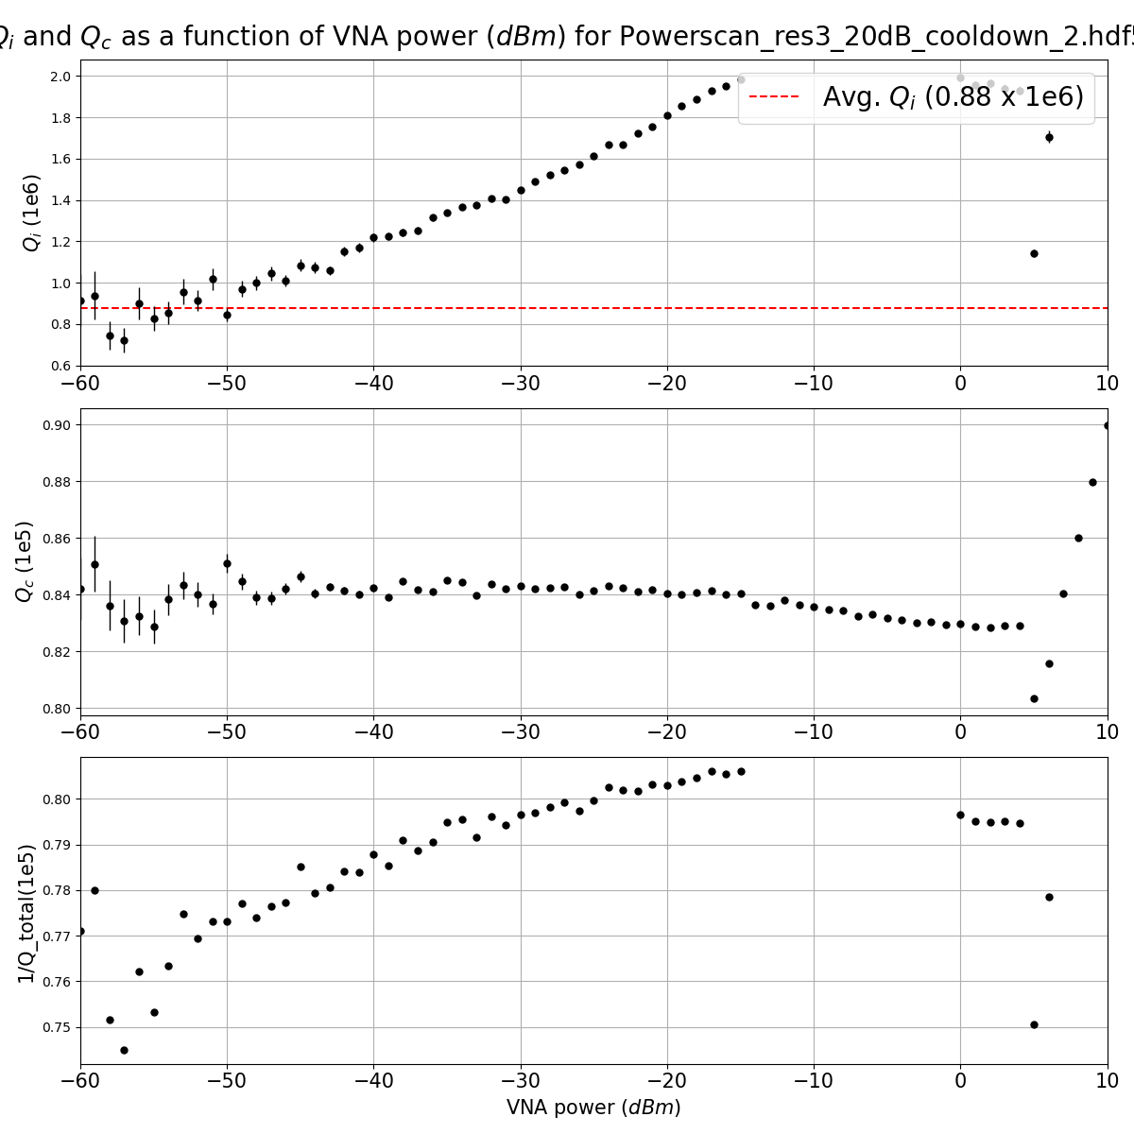
Resonators – Measurement and data treatment
Notes:
The frequency did not shift after cool-down. However, the Q_factors did. They generally became better after cooldown

Slide 17
Master thesis project plan
Resonators
Josephson junctions (training with Smitha)
Transmon
Flux tunable Transmon
Fluxonium

Slide 18
Resonators - Measurement and data
Measurement setup
2 port measurement (transmission) S_21
Measure the transmission for a lot of different output powers and find the Q_e and Q_i for each of them. Then we can plot the Q_factors as a function of the output power.

Slide 19
BUT, one thing is the theory, another one is the real data

Slide 20
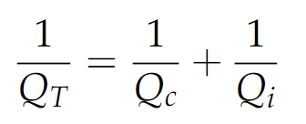
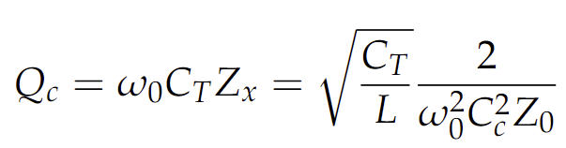
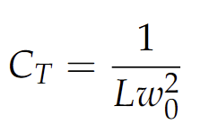
Resonators – Quality factor
l
lc
Notes:
We are looking at a system where the resonator is capacitively coupled to the transmission line.
Now that we know how to calculate the impedance, we can now look at the second parameter which determines a resonator, is the quality factor:
The total quality factor is divided into an internal and external quality factor.
The coupling quality factor is often simulated. Here we just need the inductance and the resonance frequency and the impedance (we assume we have 50 ohm impedance all the way through). Ww also need the coupling capacitance (which we can find using Ansys or it is calculated using.
In Practical

Slide 21
Resonators – Q_factors
Loss can decrease the Q_factor
TLS
Magnetic vortices loss
Quasiparticle loss
Radiation loss
Loss uncertainty
Notes:
There are many different reasons why your Q_factors might vary from time to time even though you use the same design and the same procedure. Even small defects and perturbations can cause loss and change the Q_factor. But there are a lot of different research on this!

